Slide 1
A Changing Lake Huron

Slide 2
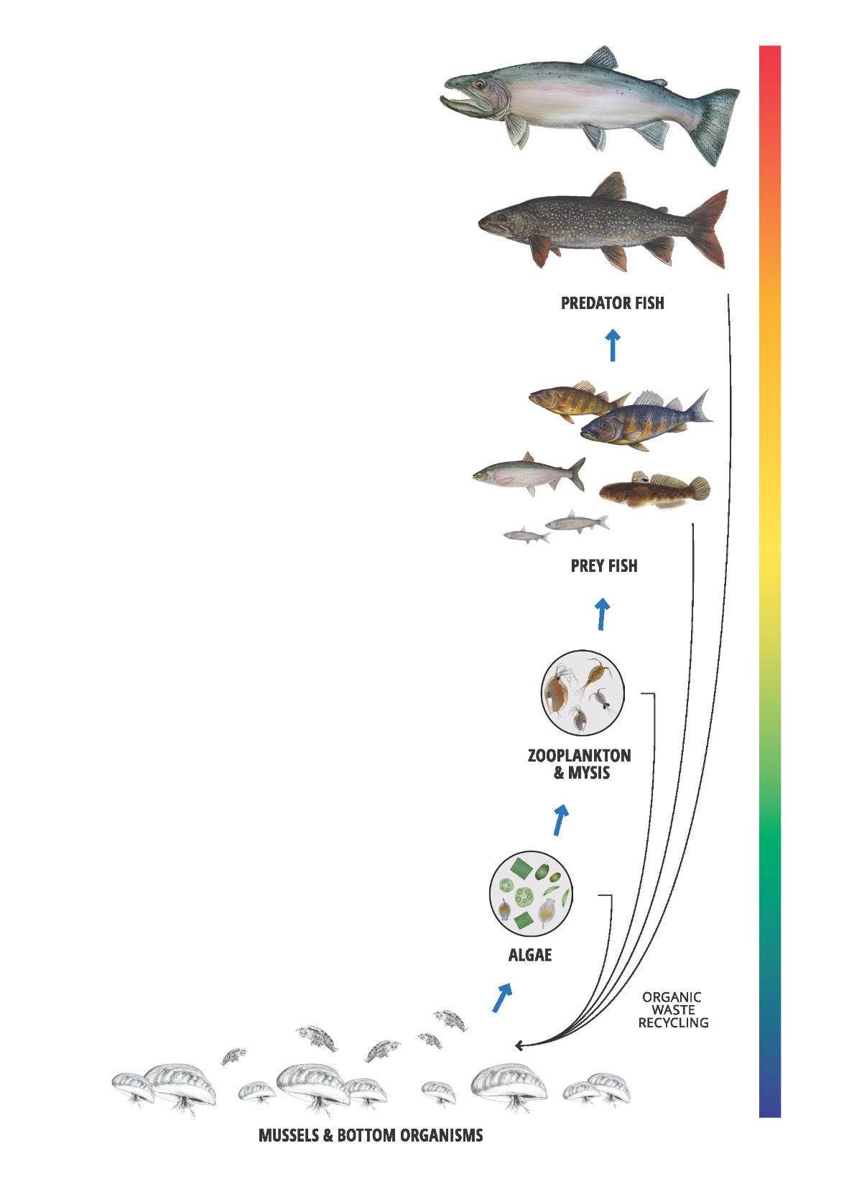
The Lake Huron Food Web
Algae is an essential component of the aquatic ecosystem; it supplies energy to all other living organisms in a food web
Phosphorus is required for algae growth
Amount of phosphorus is positively related to how much fish biomass (total weight of all living fish) it produces, but other factors are also influential:
Invasive species (e.g. quagga mussels)
Habitat availability
Water clarity
Level of fishing
Stocking
Predator-prey balance
Weather
Fisheries management
Notes:
The source of food for all living things in Lake Huron are microscopic aquatic plants called algae. Every other living organism in the lake must either eat live or dead algae directly or eat another organism that depends on algae. Although algae can reach nuisance levels under certain conditions, it is essential to the life of the lake. All aquatic animals in the lake are connected to algae through a food web (Fig. 1).
Phosphorus is an essential nutrient required for algae growth. The total weight of all living fish, termed the fish biomass, is positively related to total phosphorus, but other factors change the amount of fish biomass that can be sustained (Fig. 2). These modifying factors include changes to food web structure caused by invasions (e.g., quagga mussels), habitat availability, water clarity, level of fishing, stocking, predator-prey balance, weather, and fisheries management practices.
Summary: algae req’d by all organisms, phosphorus needed for algae to grow, therefore, total biomass is dependent on algae + phosphorus (nutrients)

Slide 3
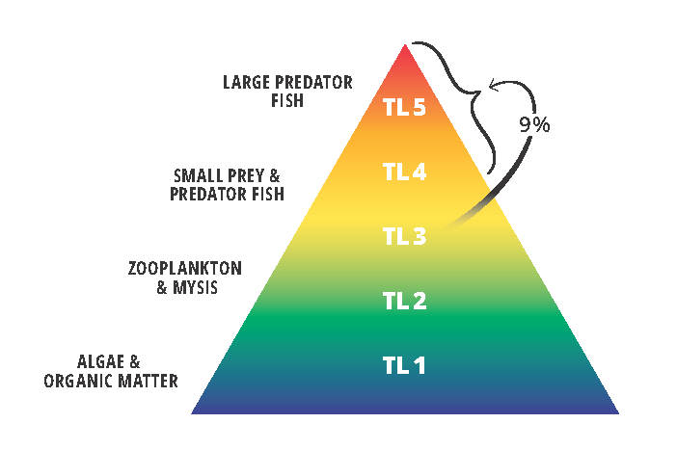
Trophic Transfer Efficiency
Some energy is lost each time a higher TL organism consumes a lower TL organism (hence, pyramid shape)
Trophic transfer efficiency = amount of food energy from one trophic level transferred to another level(s)
In the Great Lakes, the tropic transfer efficiency from TL-3 to TL-4 + TL-5 is ~9%
Notes:
Because some energy is lost each time a higher trophic level organism consumes a lower trophic level organism, food webs organized this way have a pyramid shape (Fig. 3). Scientists believe that on average about 9% of the food energy at TL-3 (small fish, large zooplankton and Mysis) is transferred to higher trophic levels (TL-4 and TL-5 combined; Fig. 3) in the Great Lakes. This percentage of energy moving up the food web is called “trophic transfer efficiency.”

Slide 4
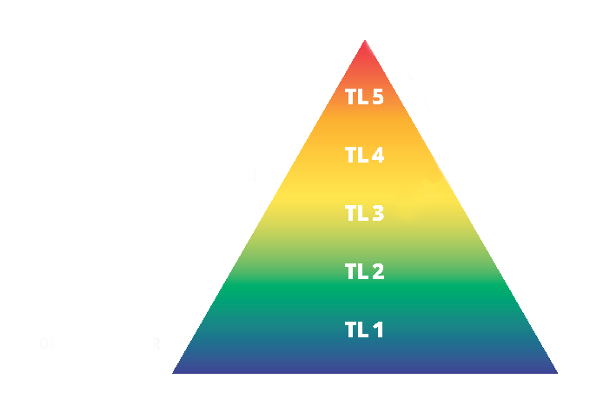

Food Web and Trophic (Energy) Levels
Lake trout, Chinook salmon, walleye, lake whitefish
Small prey and predator fish
Large zooplankton, Mysis, alewife, bloater,
Small zooplankton, quagga mussels, Diporeia
Living algae, organic material
Notes:
Because some energy is lost each time a higher trophic level organism consumes a lower trophic level organism, food webs organized this way have a pyramid shape (Fig. 3). Scientists believe that on average about 9% of the food energy at TL-3 (small fish, large zooplankton and Mysis) is transferred to higher trophic levels (TL-4 and TL-5 combined; Fig. 3) in the Great Lakes. This percentage of energy moving up the food web is called “trophic transfer efficiency.” Before the collapse of alewife, the Lake Huron food web had a lower than average trophic transfer efficiency of 6% (Fig. 4). Following the collapse of alewife in 2003, the trophic transfer efficiency dropped to 3-4% but increased to 5% in 2015. The food web is producing 2x fewer predator fish for a given level of nutrients than is average for the Great Lakes.

Slide 5
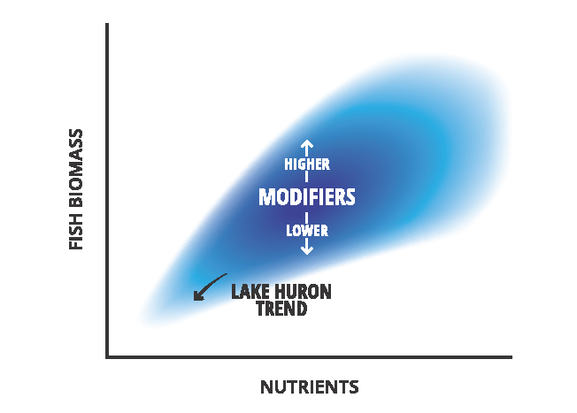
Nutrients and Fish Biomass
Total phosphorus in Lake Huron declined by 50% from 1995 to 2003
Phosphorus levels are currently stable at 2.5-3.0 mg/L
Generally, the decline in Lake Huron nutrients means that less fish biomass can be produced
Notes:
Lake Huron total phosphorus levels vary widely across the lake. A good indicator of overall change is long-term monitoring of offshore (> 40m deep) total phosphorus levels in the spring and summer.
Total phosphorus declined by 50% from 1995 to 2003 (4 mg/L to 2 mg/l). Levels have since increased slightly and stabilized at approximately 2.5-3.0 mg/L. The decline in nutrients means that Lake Huron can support less overall fish biomass than it did before 2000 (Fig. 2).
Summary: Due to decline in nutrients, Lake Huron can support less biomass than it did in 2000.

Slide 6
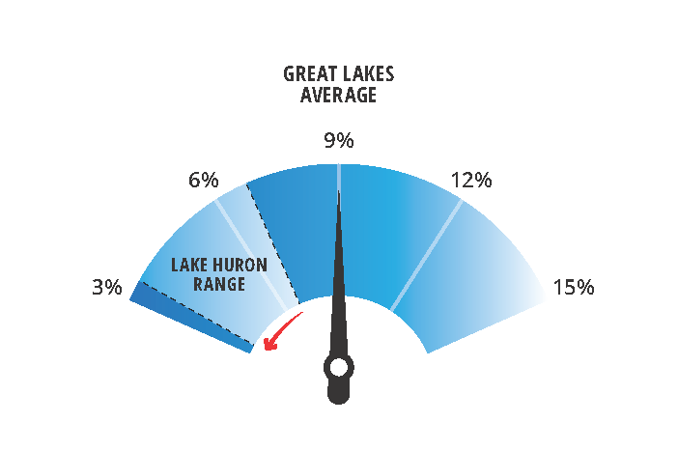
Lake Huron Trophic Transfer Efficiency
Before the collapse of alewife, the average Lake Huron trophic transfer efficiency was 6%
In 2003, following alewife collapse, trophic transfer efficiency dropped to 3-4%; increased to 5% in 2015
Compared to other Great Lakes, Lake Huron’s food web is less efficient
The Lake Huron food web is producing 2x fewer predator fish for a given level of nutrients than the average for the Great Lakes
Notes:
Before the collapse of alewife, the Lake Huron food web had a lower than average trophic transfer efficiency of 6% (Fig. 4). Following the collapse of alewife in 2003, the trophic transfer efficiency dropped to 3-4% but increased to 5% in 2015. The food web is producing 2x fewer predator fish for a given level of nutrients than is average for the Great Lakes.

Slide 7
Trophic Transfer to Specific Fish Species
A more efficient food web means more energy gets transferred to fish
The most recent food web information tells us that energy is being transferred relatively efficiently to lake whitefish, Chinook salmon, lake trout, round goby, and small coregonines
Managers have limited actions they can apply
Notes:
Higher biomass of a specific fish species requires food web structures that channel sufficient energy from the bottom of the pyramid (TL-1; Fig. 3) to the species of interest. This can be estimated as the percentage of all algal and organic material produced (TL-1) transferred to specific species (Fig. 5). During 1988-2003, the Lake Huron food web supported abundant prey fish species and though quagga mussels were well established, the food web was functioning. Thus, a high percentage of algal production was channeled to predator fish (bigger bars, Fig. 5). In 2003, the collapse of alewife and other changes resulted in much less efficient trophic transfer (smaller bars, Fig. 5). For example, lake trout received only 2.4% of TL-1 production after the alewife collapse (2003) versus 9.2% just before the collapse (1998-2002) (Fig. 5). The most recent data for 2015 indicate overall trophic transfer efficiency improved (increase in bar width, Fig. 5) with increases specifically to lake trout (5.7%) and lake whitefish (19.5%, Fig. 5).

Slide 8
Implications for Fisheries Management
The Lake Huron ecosystem is continually changing
Nutrients have declined, water clarity increased, food web is disrupted, and populations of some desirable fish species have declined
Fisheries management actions that enhance food web efficiency may be helpful
Lake Huron Committee considerations:
Lower abundances of important fish species should be expected
Rehabilitation of native prey fish may help food web function and increase trophic transfer efficiency
Non-native mussels have altered food web structures, impede desirable species
Nearshore & bay fisheries are responding positively to food web changes
Research to better understand how food web changes affect fisheries is needed
Notes:
The Lake Huron ecosystem has changed, and continues to do so. Nutrients have declined, water clarity has increased, the food web is disrupted, and populations of some desirable species of fish have declined. Fisheries and environmental management activities can help sustain and improve fisheries. The Lake Huron Committee, with partner agencies, seeks to achieve a balanced, proactive approach to rehabilitate the food web, improve water quality, minimize impacts of invasive species, and develop and sustain fisheries. Important considerations for managers in this changing Lake Huron ecosystem include:
Lower abundances of important fish species should be expected due to reduced nutrients and a disrupted food web.
Rehabilitation of native prey may improve food web function and increase trophic transfer efficiency.
Non-native mussels have altered food web structure and impede production of some desirable species.
Nearshore and bay fisheries are responding positively to food web changes.
Research to better understand how food web changes affect fisheries is needed.

